Slide 1

Password Generator and Manager
By: Sekou Bamba and Matthew junkins

Slide 2
Table of Contents
Project Overview
Project Objectives
Methodology
Challenges and Risks
Results and summary
System Implementation

Slide 3
Project Overview
Our website generates strong passwords according to the user’s specifications and stores them. Users currently prioritize convenient passwords over secure ones, risking their accounts becoming compromised. We wanted to create a website that makes the hassle of creating and storing strong passwords easier.

Slide 4
Project Objectives
Secure password generation
Local storage of credentials
Easy to use UI
Reduce reliance on easy-to-use passwords

Slide 5
Methodology
Development Approach
Used A/B testing to compare UI layouts
Tools Used:
VS Code
GitHub
Browser Developer Tools

Slide 6
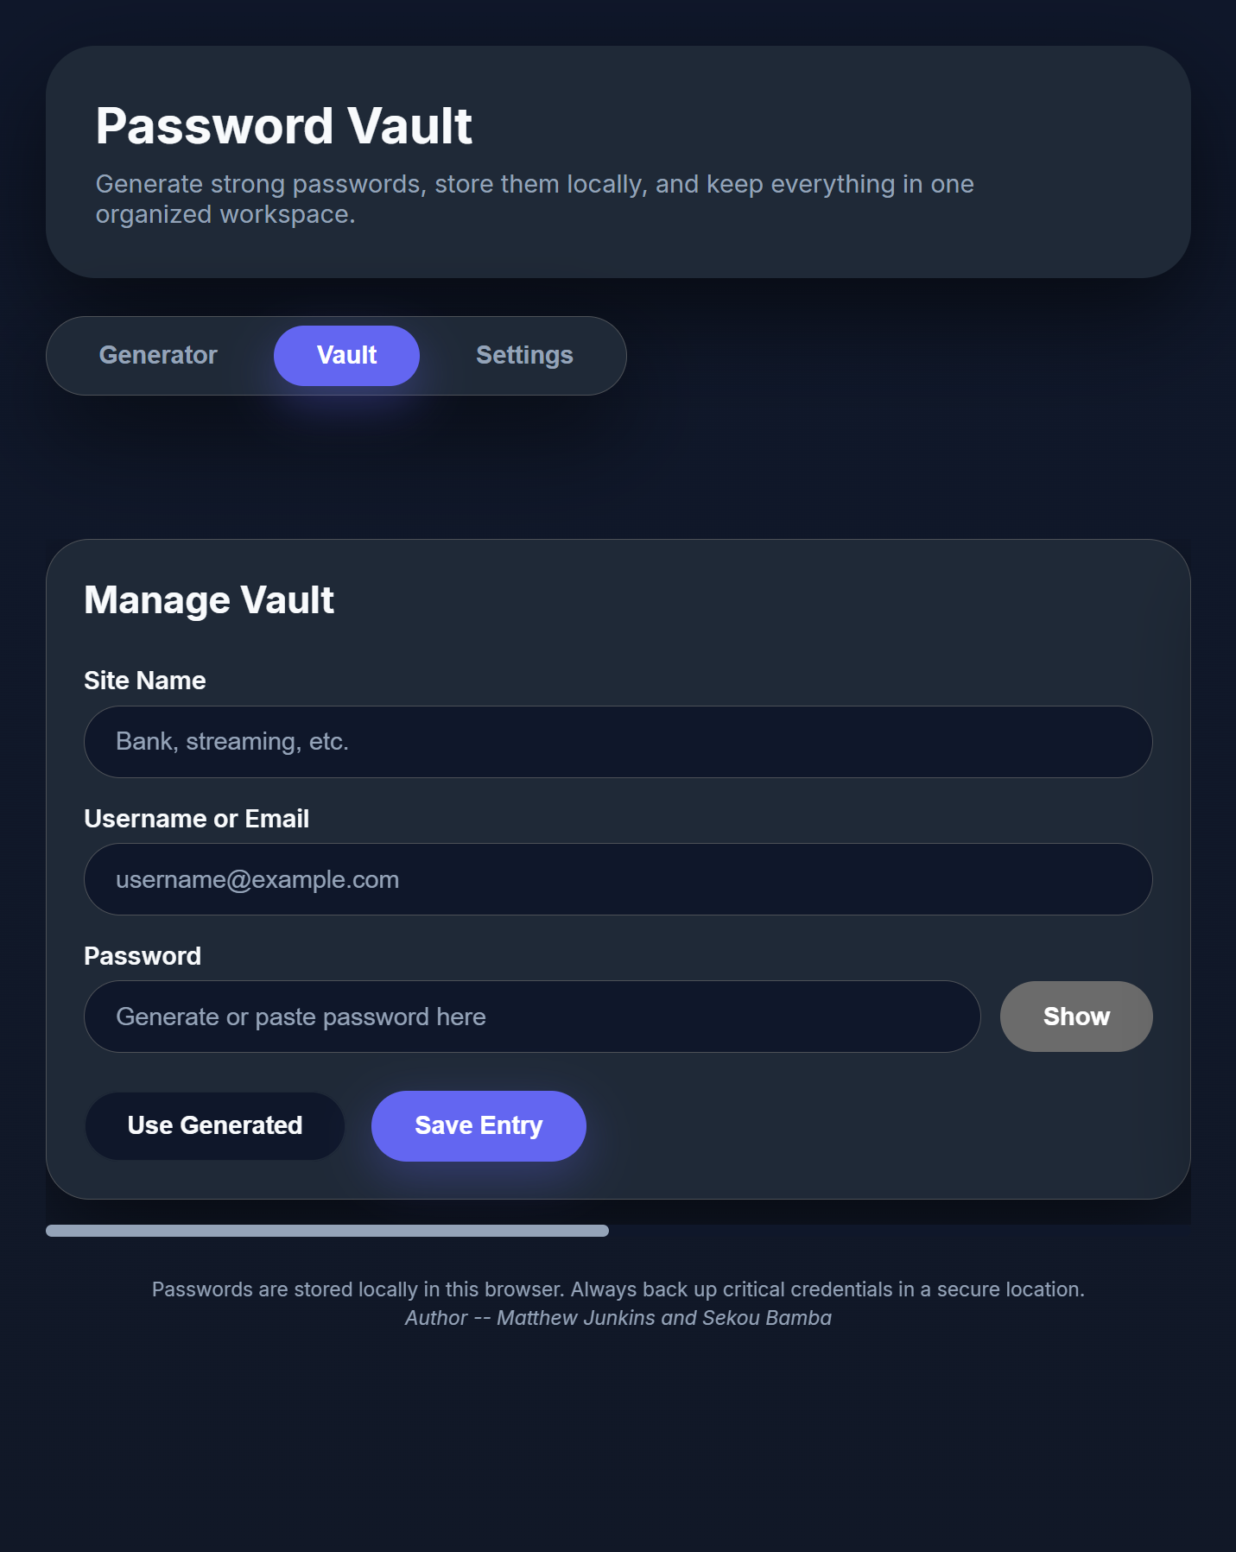
System Implementation
HTML
Hero header explaining app purpose
Tab navigation:
  Generator
  Storage and manager
  Settings
Slider for switching sections in the Storage tab

Slide 7
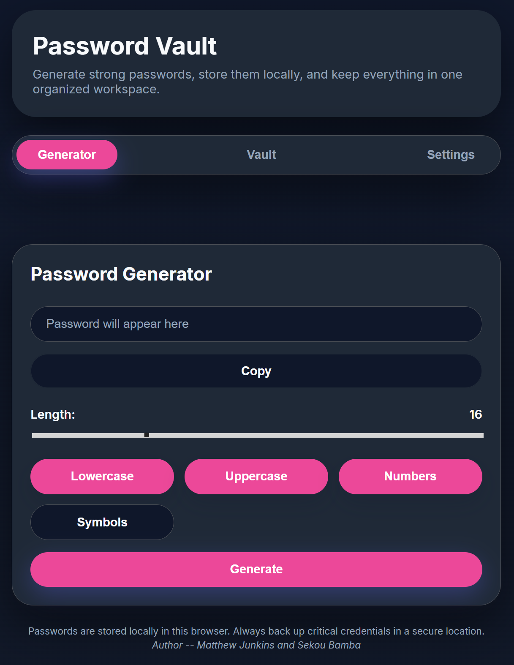
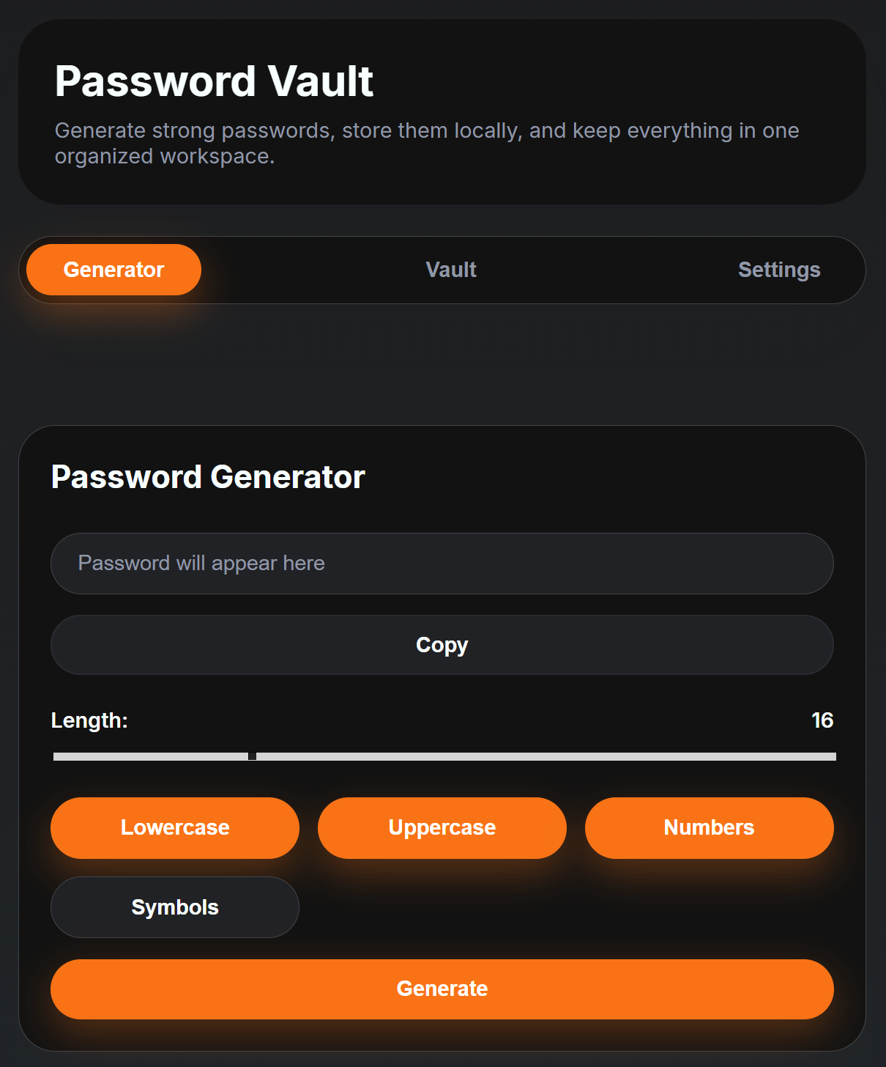
System Implementation
CSS
Modern card-based design
Light & Dark mode support
Responsive for different screen sizes
Rounded corners and soft shadows
Custom color variables
Grid and Flexbox layout

Slide 8
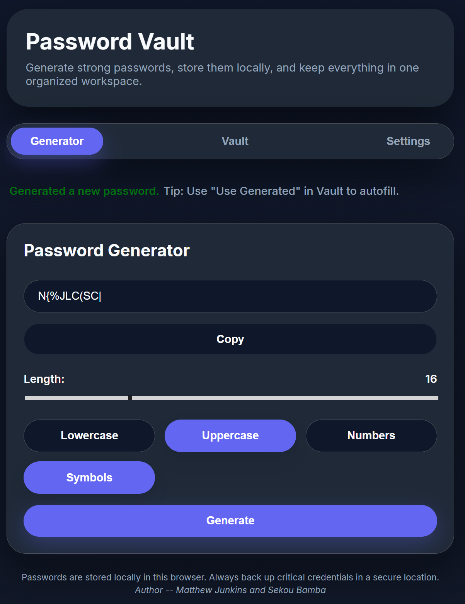
System Implementation
Javascript
  Password Generator:
  Custom password rules

Slide 9
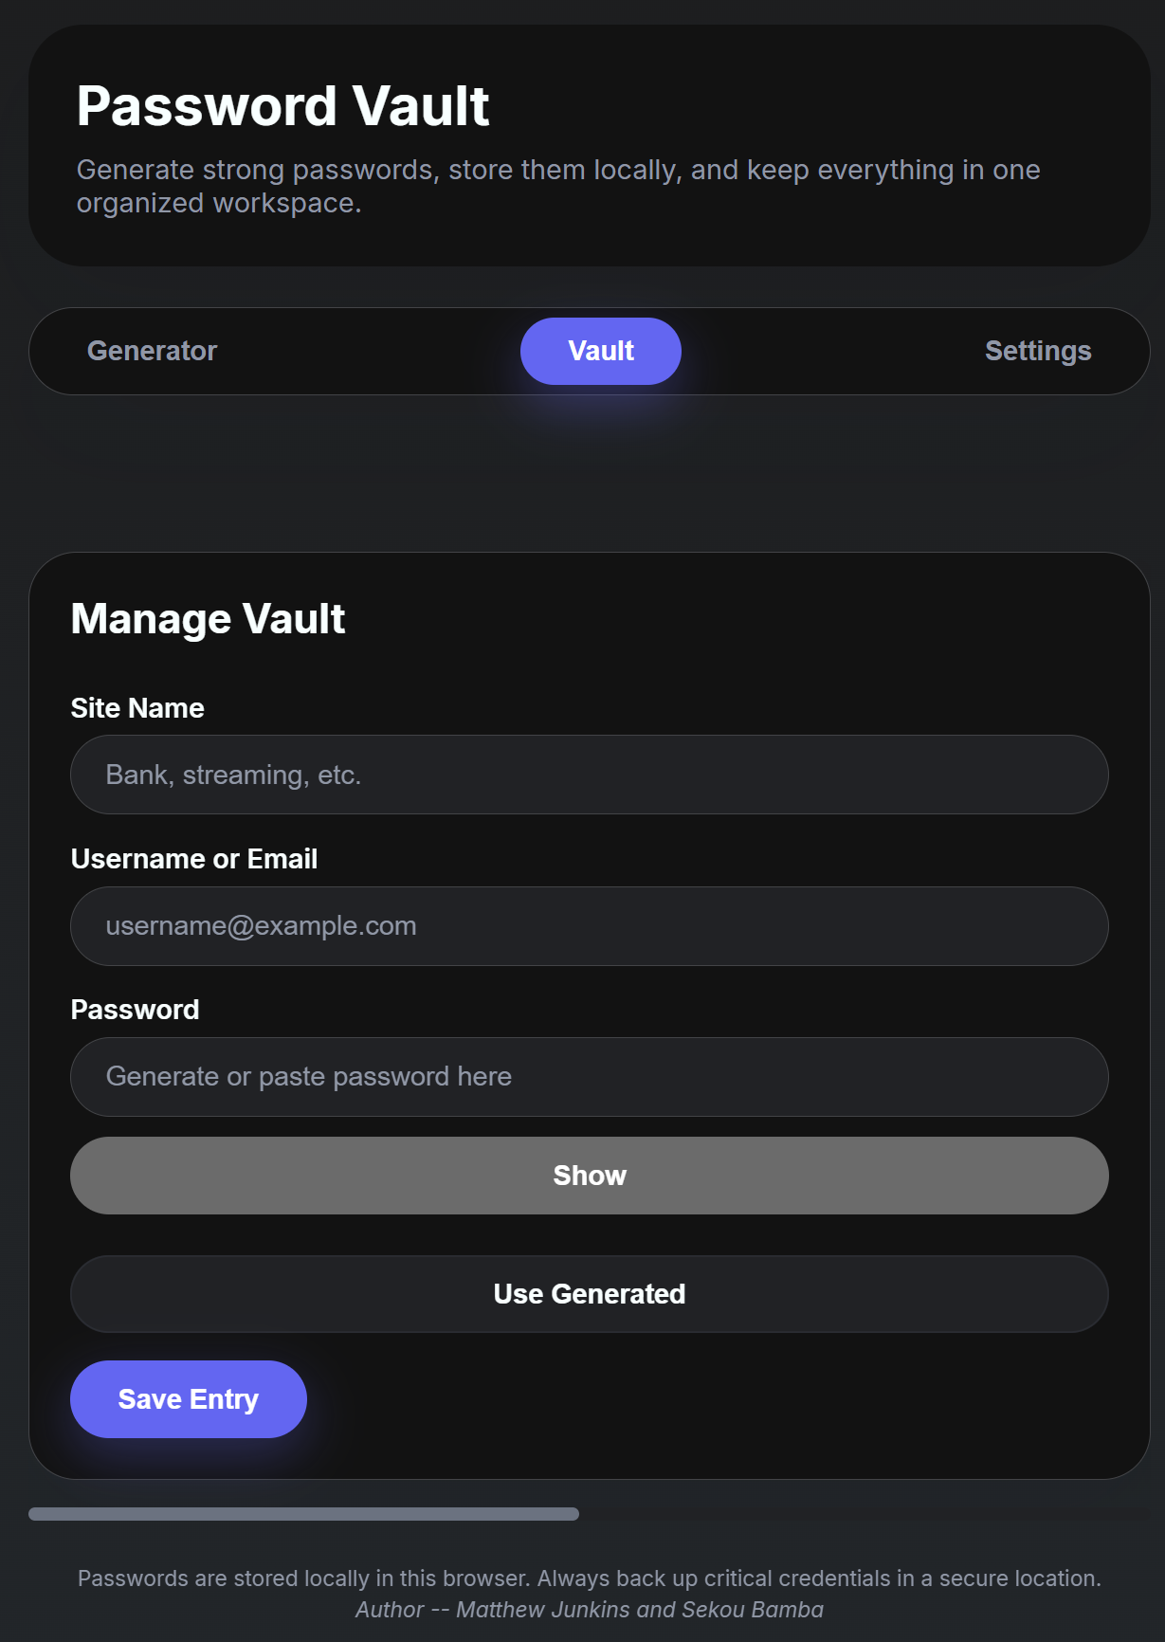
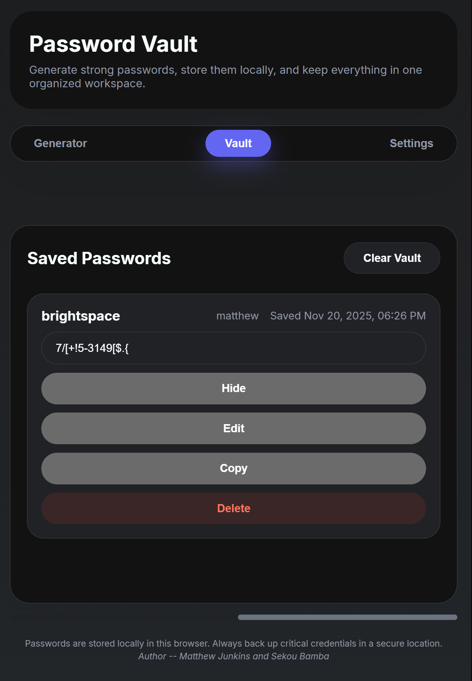
System Implementation
Javascript
  Password Generator:
  Custom password rules
  Password Manager
  Save entries with label, username, and password
  Copy, show/hide, edit, delete options

Slide 10
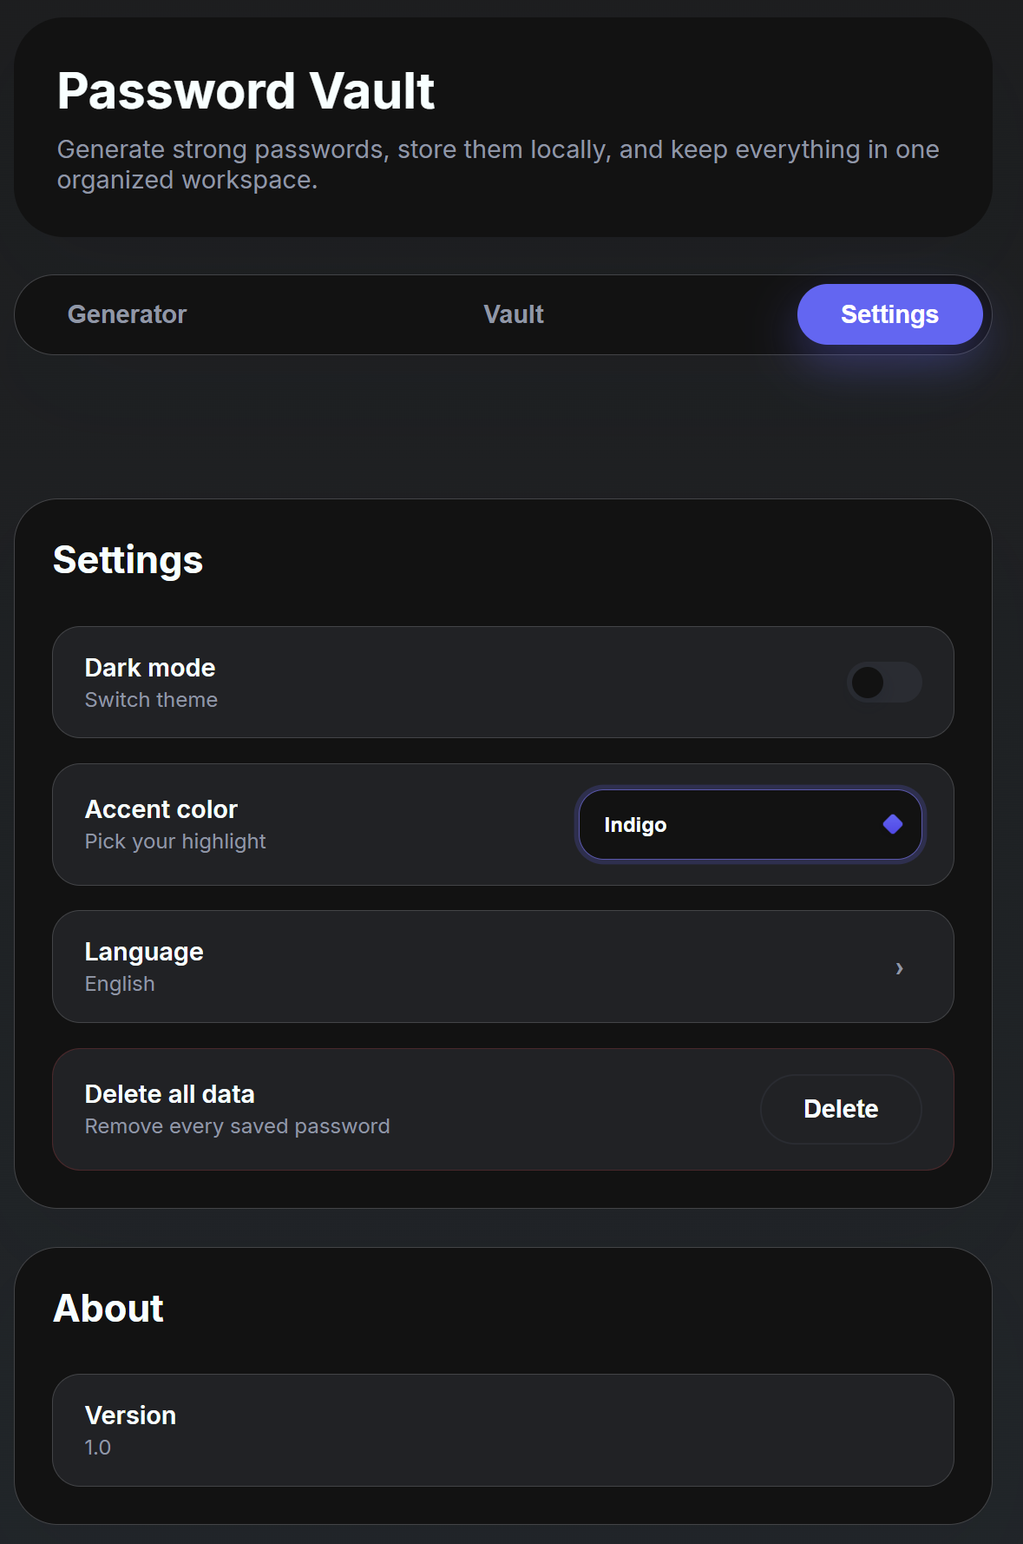
System Implementation
Javascript
  Password Generator:
  Custom password rules
  Password Manager
  Save entries with label, username, and password
  Copy, show/hide, edit, delete options
  Settings
  Dark/light mode toggle
  Accent color changes
  Delete all saved data

Slide 11
Challenges and Risks
Problems
  Password generator
  Tab selection
  Saving password to storage
  Clipboard

Slide 12
Results and summary
Strong password generation
Passwords can be saved, edited, and deleted
Easy to use UI across browsers
Customization for users

